Slide 1
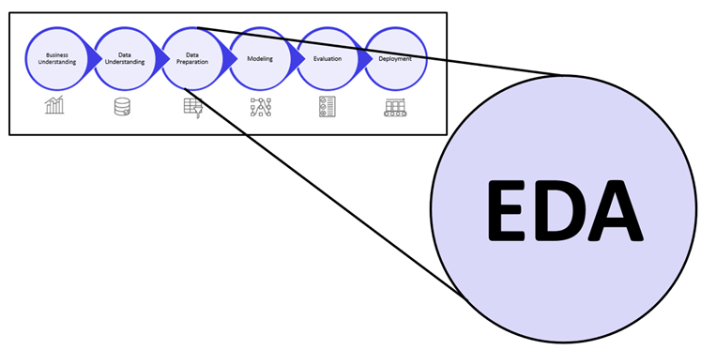
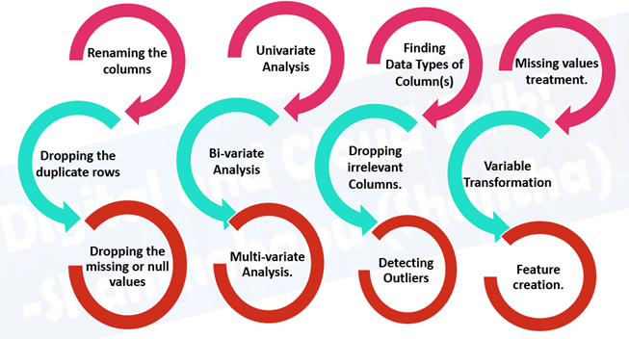
BANK LOAN DEFAULT RISK ANALYSIS

Slide 2
Introduction
RISK factors associated in lending a LOAN
Importing Libraries and Understanding data
Data Cleaning and Manipulation
Analyze & Delete Unnecessary Columns
Filling null values
Univariate Analysis
Bivariate Analysis
Conclusion

Slide 3
INTRODUCTION
This case study aims to give an idea about applying EDA in real business scenario.
In this case study we will develop a basic understanding of risk analytics in banking and financial services.
To understand the patterns which we predict based on the data is used to minimize the risk of losing money while lending loans to customers.

Slide 4
RISK factors associated in lending a LOAN:
The project Bank Loan Default Risk Analysis is to predict whether customer is capable to repay the loan or a defaulter to bank.
When the bank receives a loan application, bank has to decide whether applicant is capable of repaying the loan are not.
Identification of such applicants using EDA is the aim of this case study and to reduce risks for banks.
Banks wants to understand the main attributes that are behind loan defaults.

Slide 5
Data preprocessing
Getting Jupyter Ready
Importing Packages
Reading and Understanding Data
Data Cleaning
Data Manipulation
Data Analysis
Conclusions

Slide 6
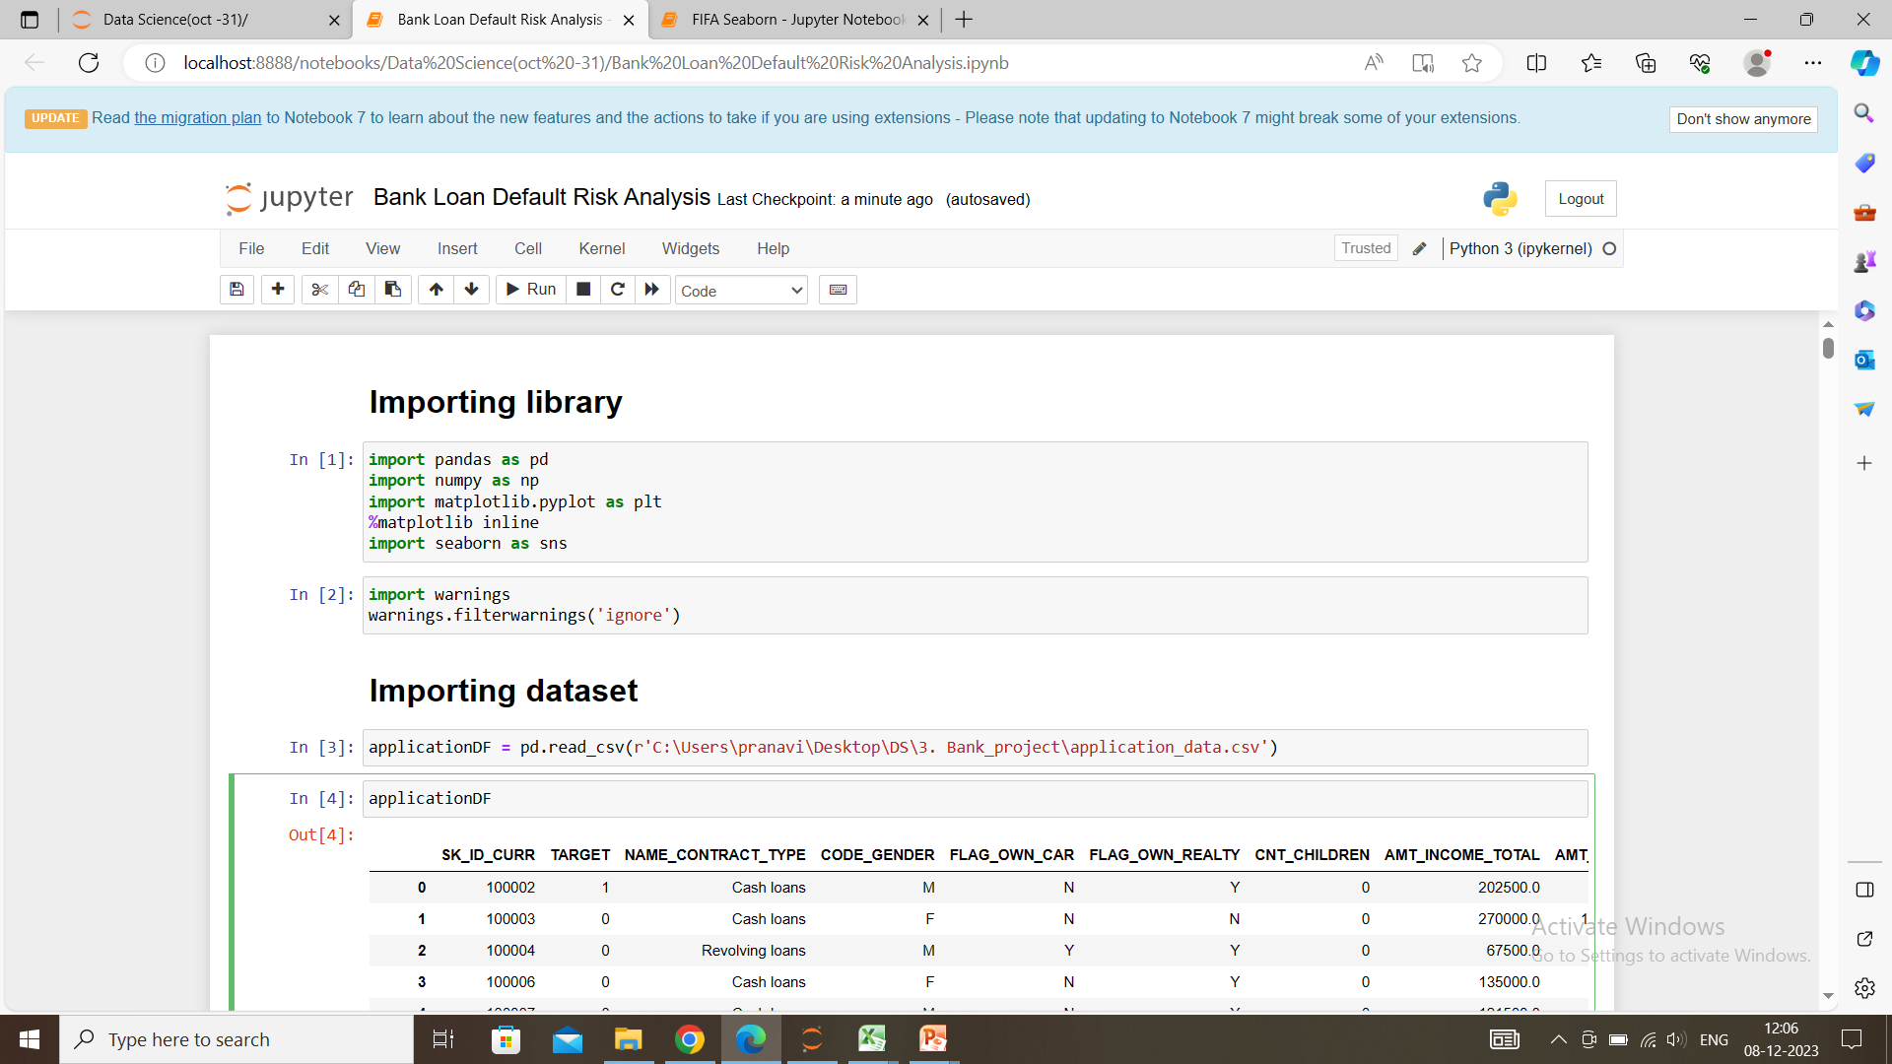
Getting Jupyter Ready : Importing Libraries
Import required library to read the dataset, to visualize the data.
Pandas provides functionality for:
Reading and writing data in various formats (CSV, Excel, json, etc.).
Cleaning and preprocessing
data (handling missing
values, filtering,sorting, etc).
Plotting and visualizing data.

Slide 7
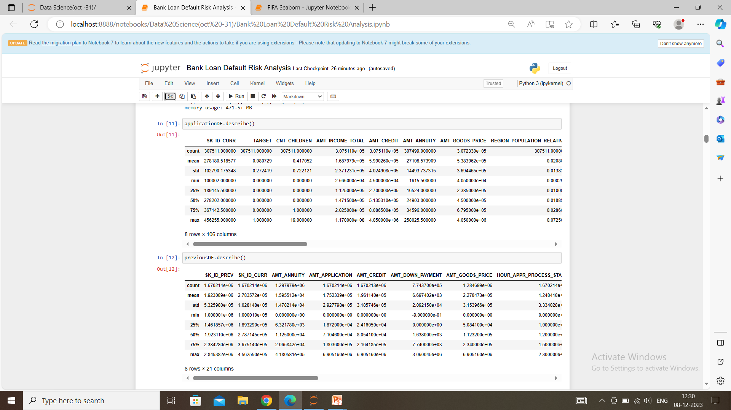
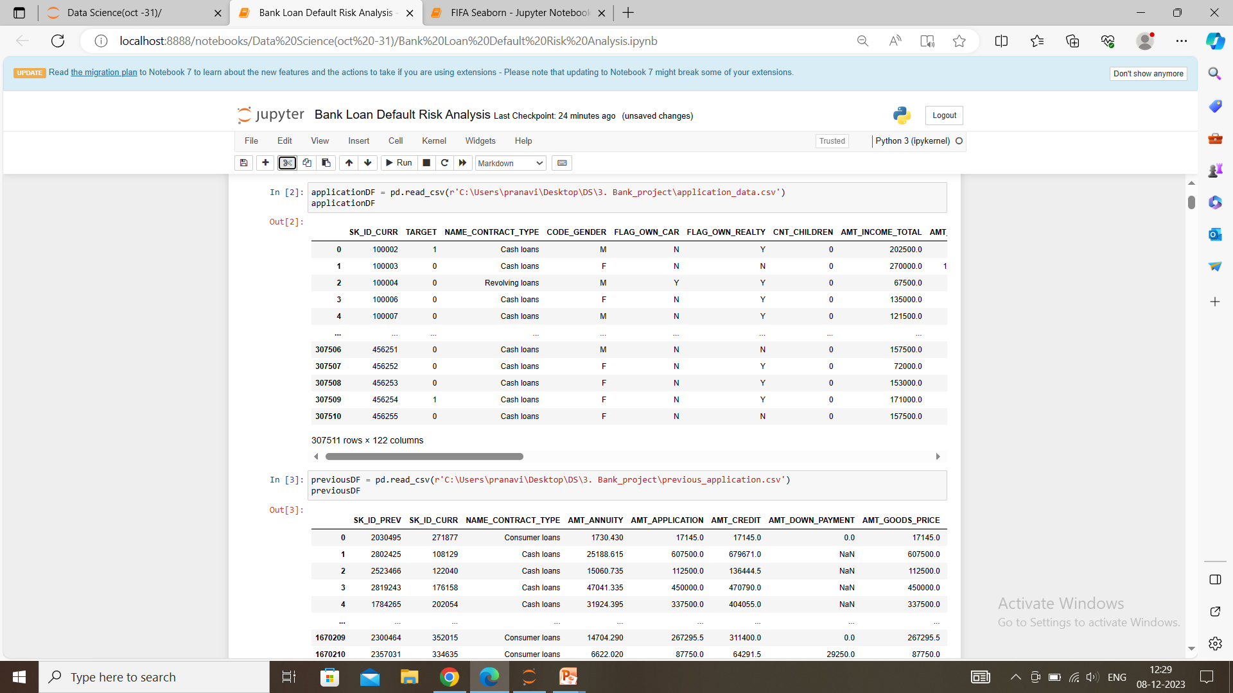
Reading and Understanding data
Importing data using pandas and to understand by using metrics like shape(), info(), describe(), isnull() - if there any null values.

Slide 8
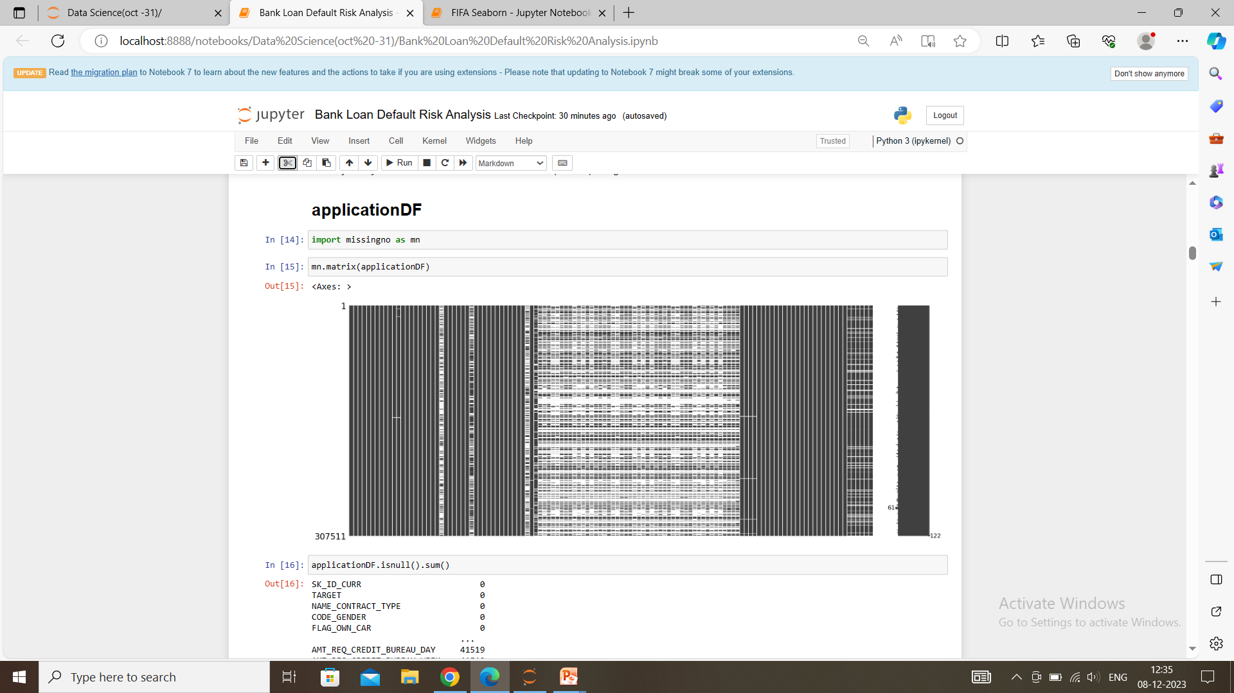
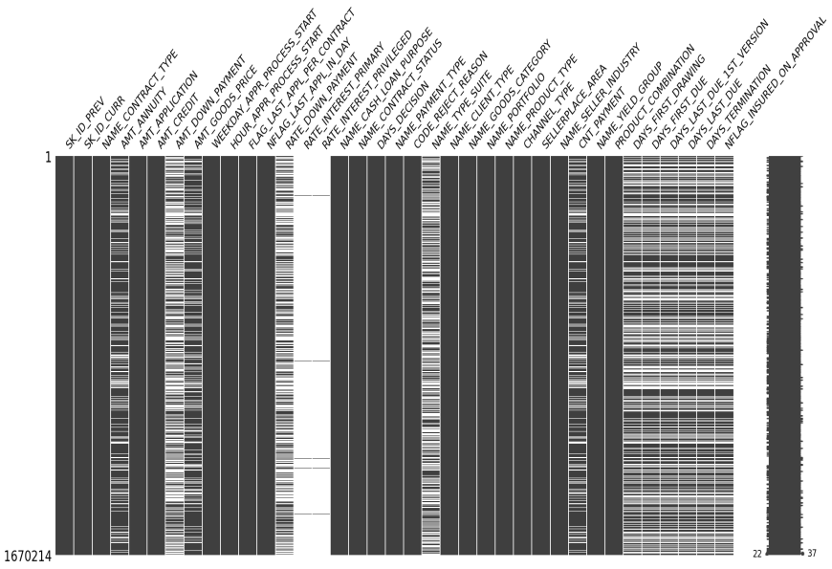
Data Cleaning and Manipulation
Insight : Based on the above Matrix, it is showing gaps where the dataset has many missing values.

Slide 9
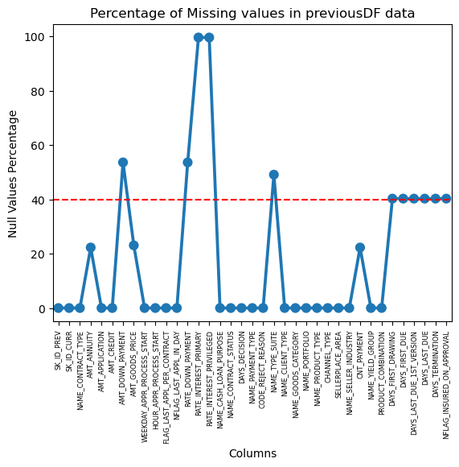
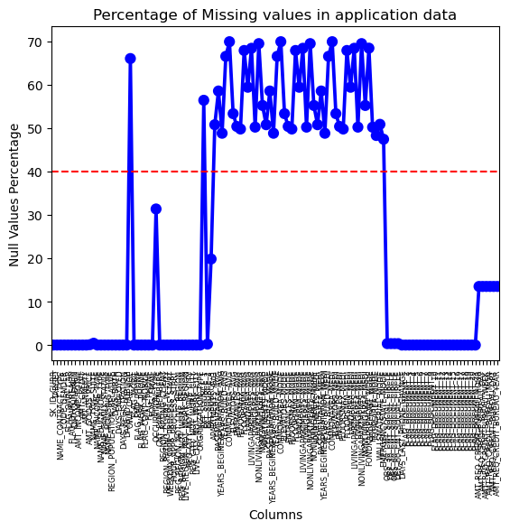
NULL VALUES > 40%
From the plot we can see the columns where the null values more than 40% are marked above the red line and the columns which have less than 40 % null values below the red line.

Slide 10
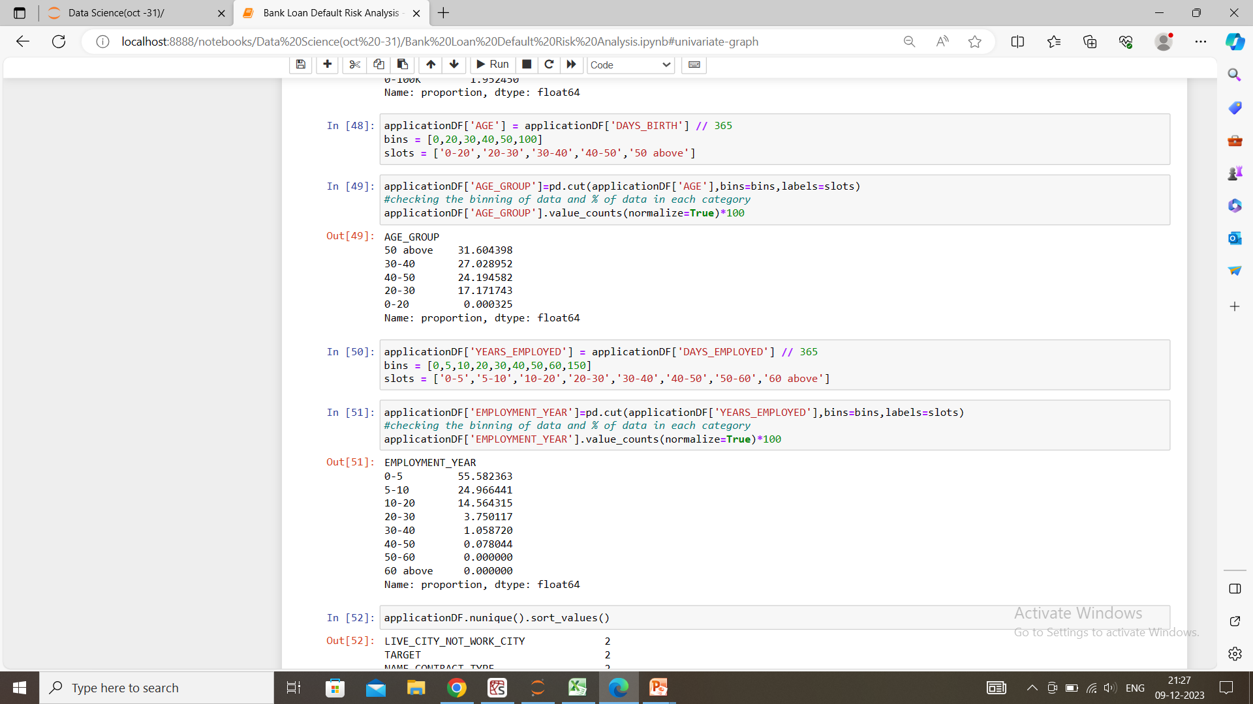
BINNING
31% loan applicants have age above 50 years. More than 55% of loan applicants have age over 40 years.
More than 55% of the loan applicants have work experience within 0-5 years and almost 80% of them have less than 10 years of work experience

Slide 11
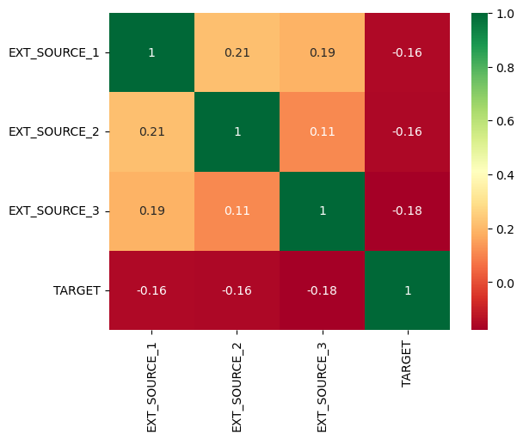
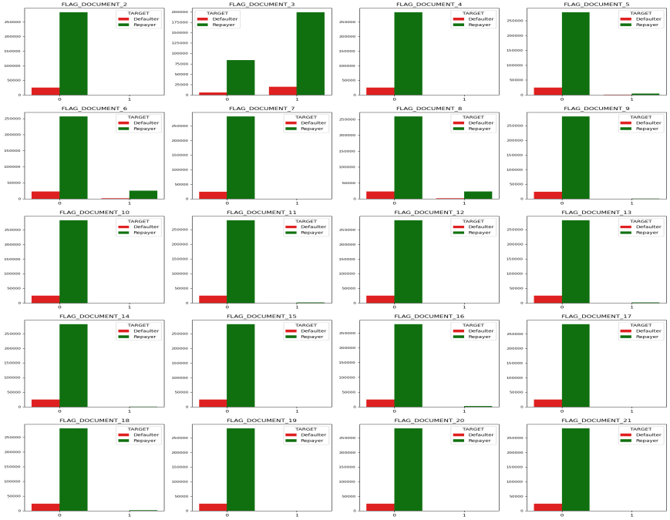
Analyze & Delete Unnecessary Columns
Based on the Heatmap,
we can see there is almost no
correlation between EXT_SOURCE_X
columns and target column, thus
we can drop these columns.
By this graph we can understand
clients who applied for loan has not
submitted FLAG_DOCUMENT_X
except FLAG_DOCUMENT_3 and
we can delete rest columns.

Slide 12
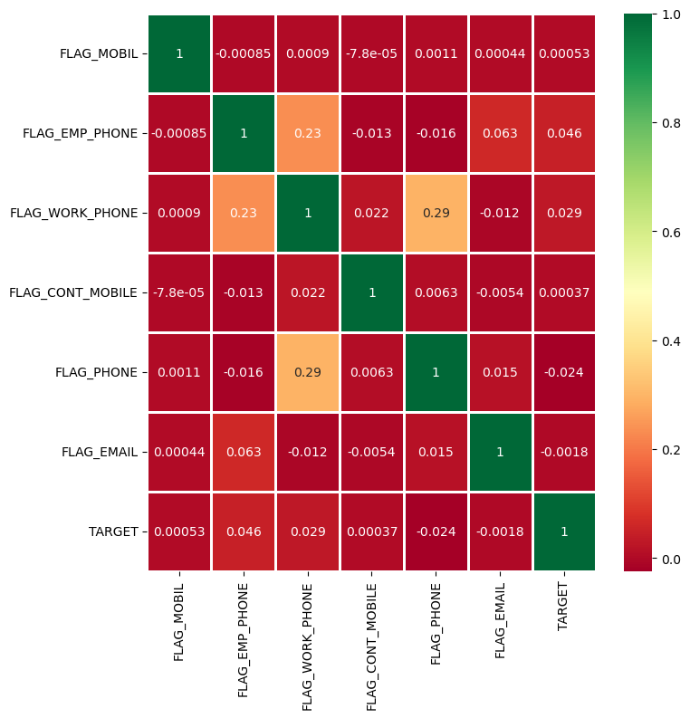
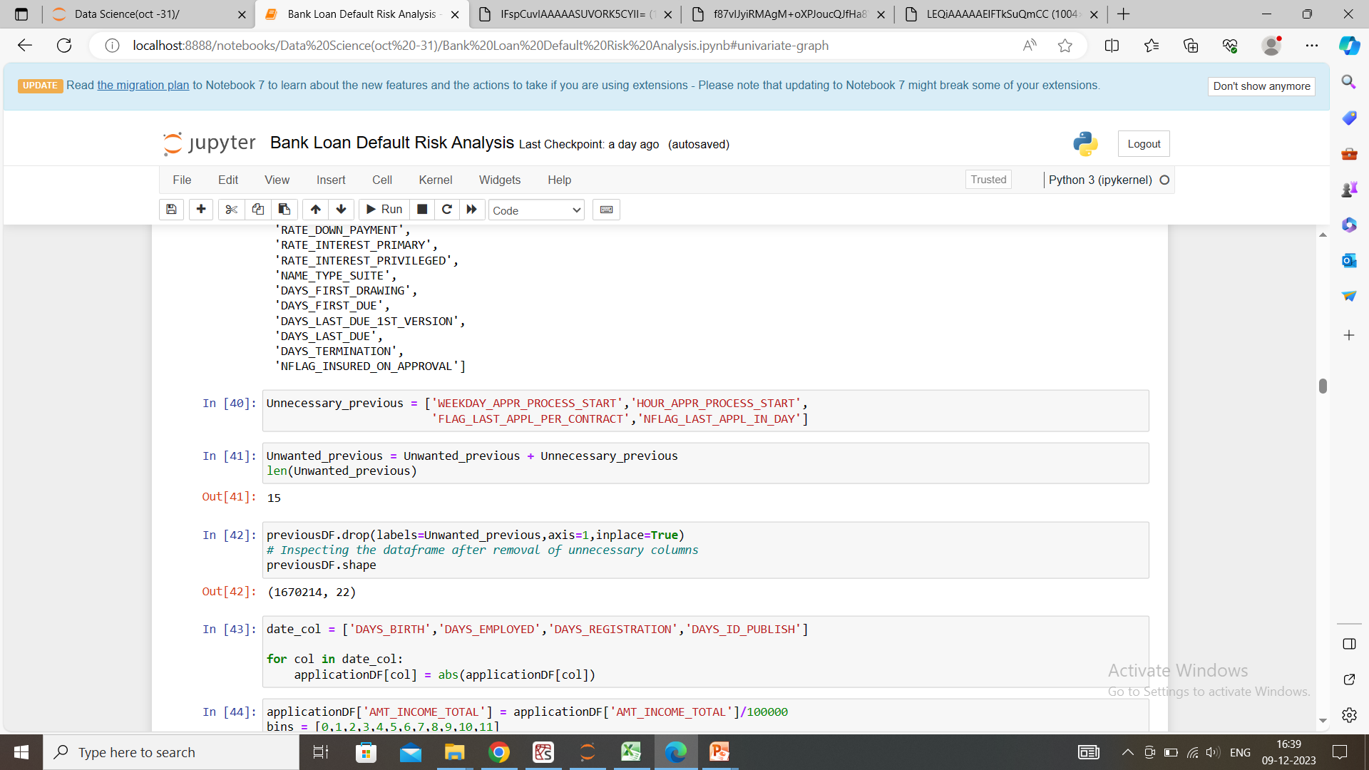
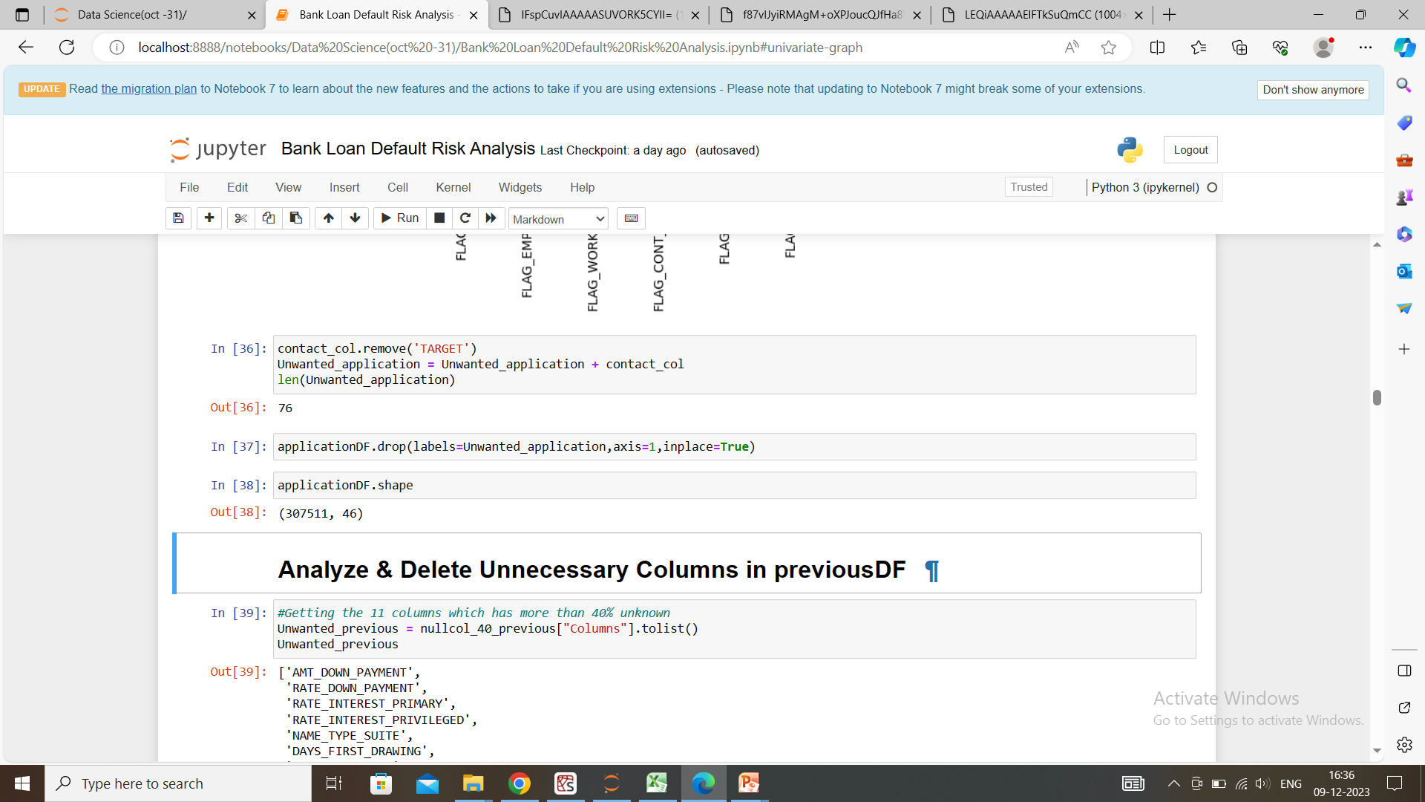
VISUALIZATION
Insight: There is no correlation between attributes of mobile, email etc with loan repayment thus these columns can be deleted.
Deleting unnecessary attributes
from the datasets.

Slide 13
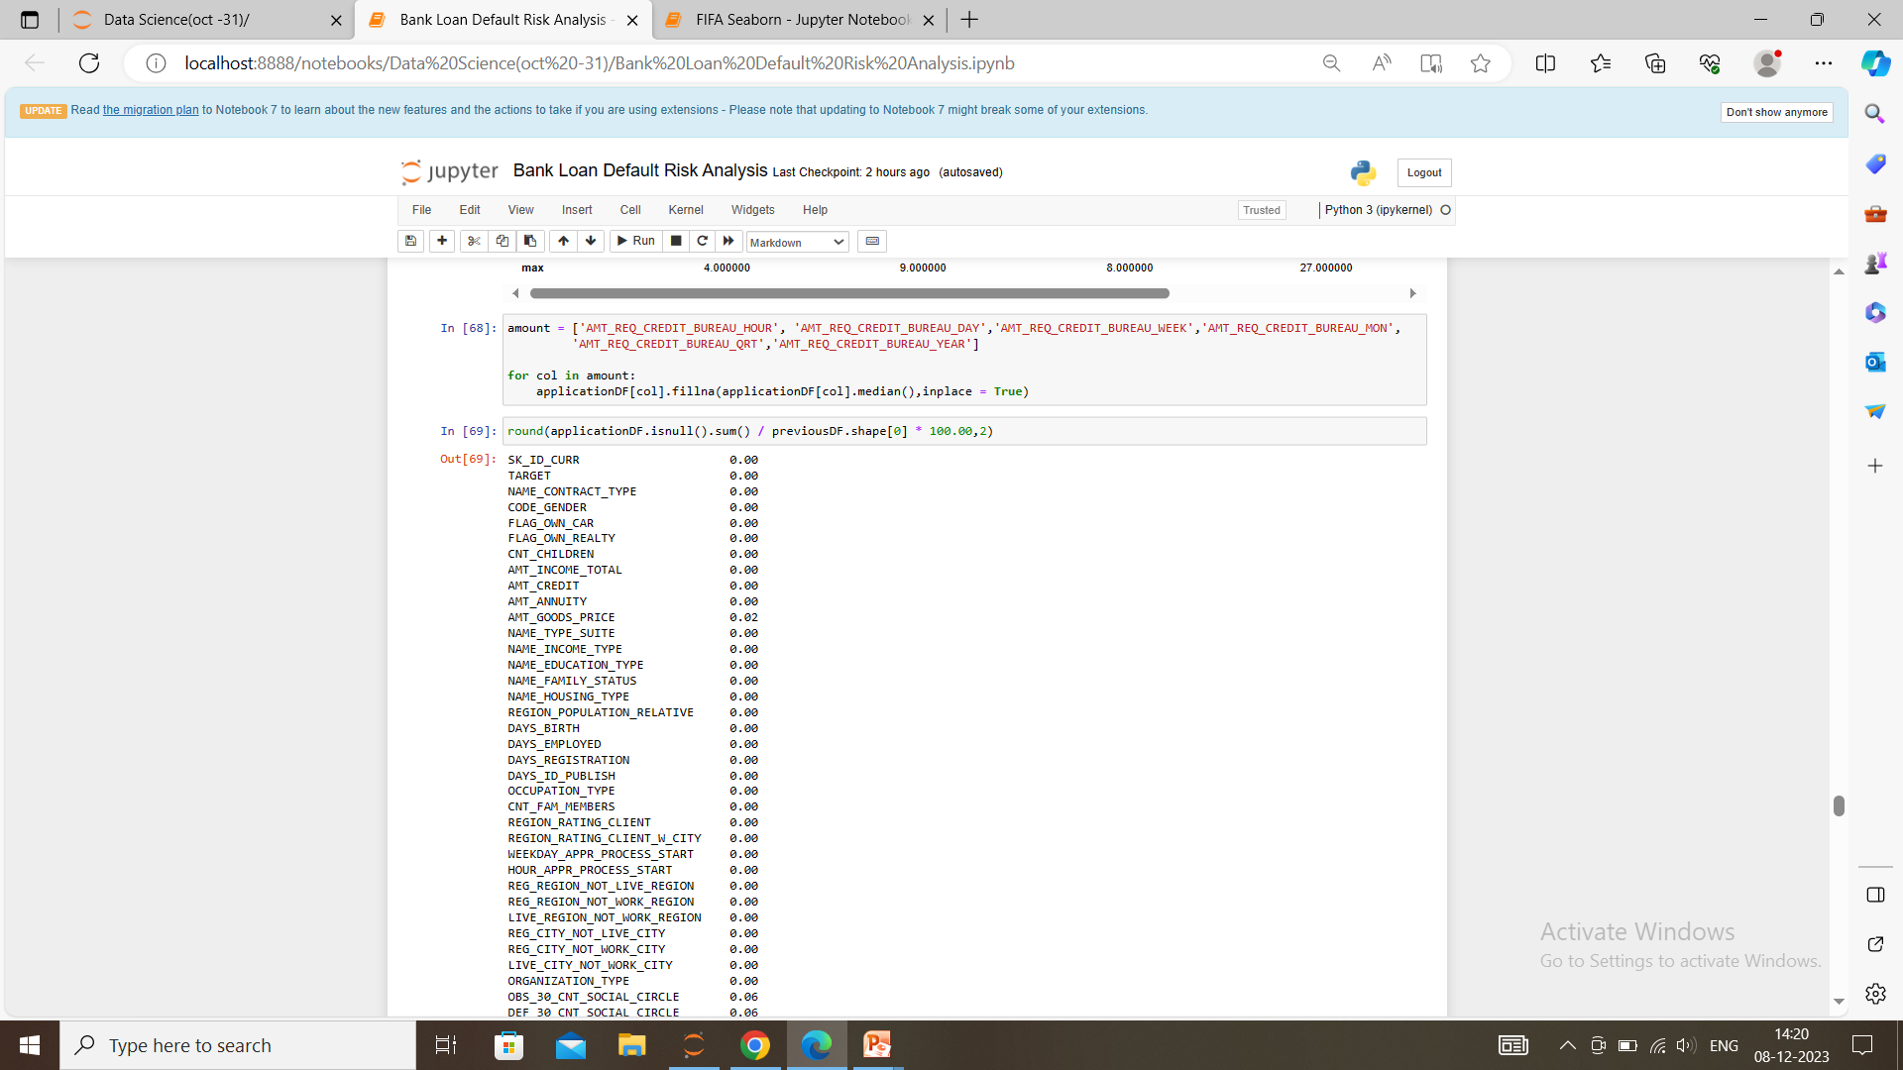
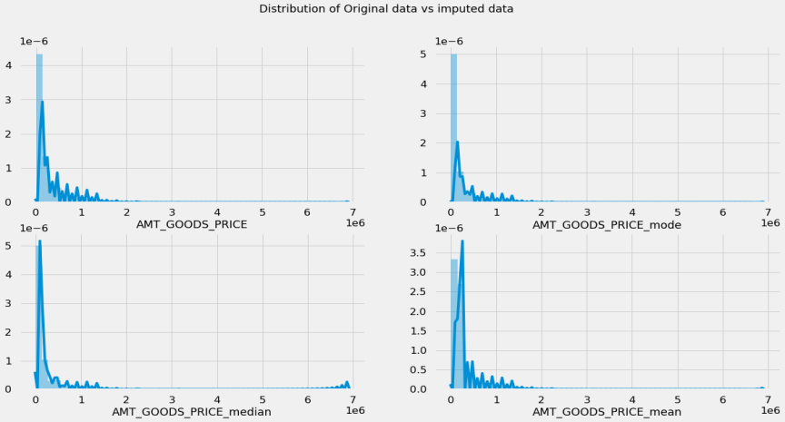
Filling null values
To fill null values we use fillna through mean, median, mode strategy for numerical data and we use mode strategy for categorical data..
Original distribution is
closer with the distribution
of data when the impute is
done with mode strategy.

Slide 14
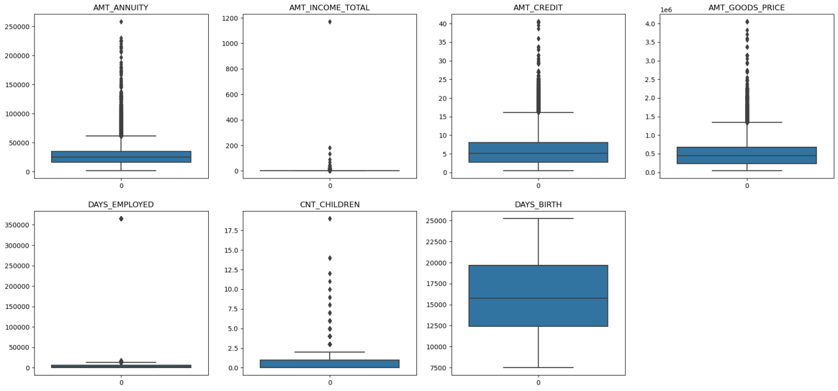
OUTLIERS
AMT_INCOME_TOTAL has huge number of outliers which indicate that few of the loan applicants have high income when compared to the others.
DAYS_BIRTH has no outliers which means the data available is reliable.

Slide 15
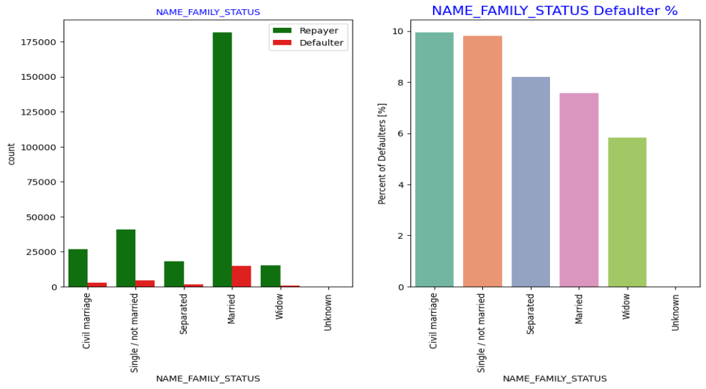
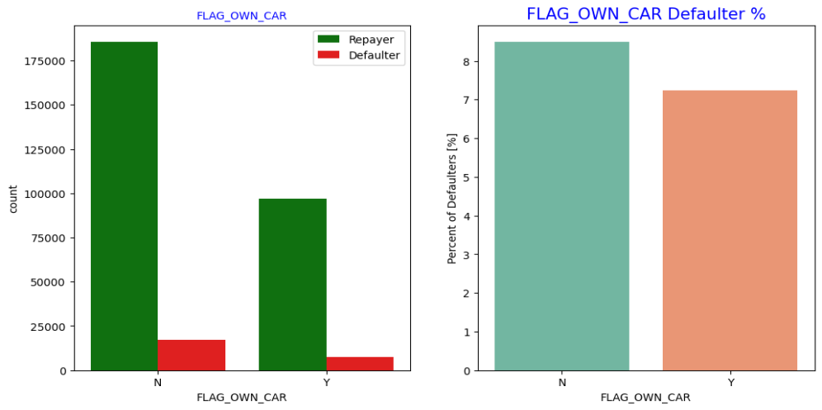
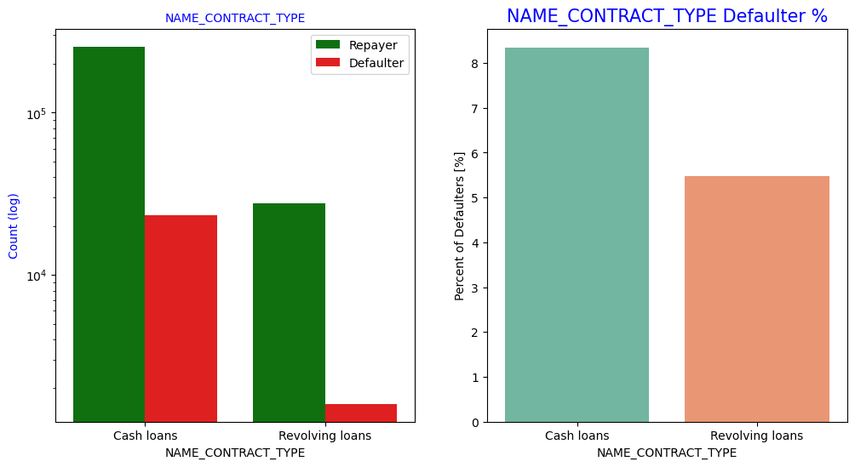
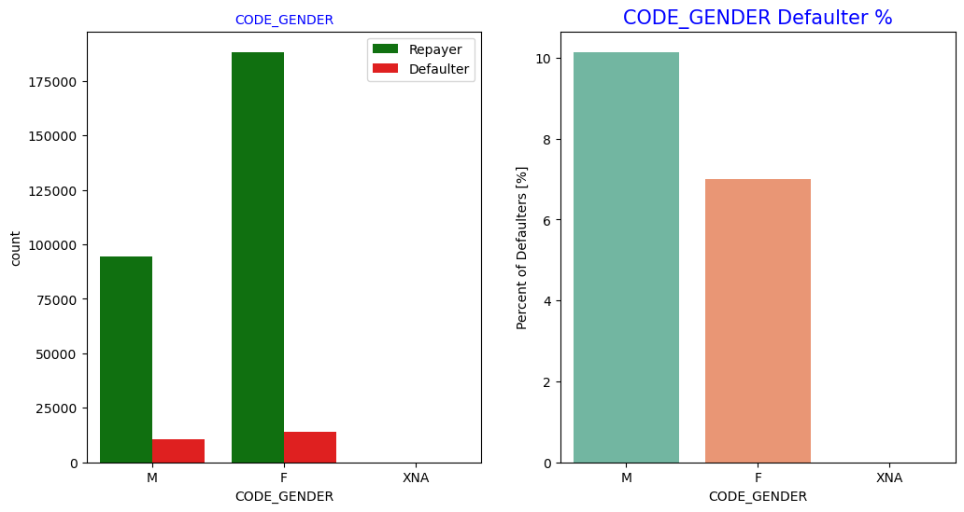
Univariate Analysis
Cash Loan, person without own car, male, civil marriage members have more defaulter percentage
when compared with their respective attributes.

Slide 16
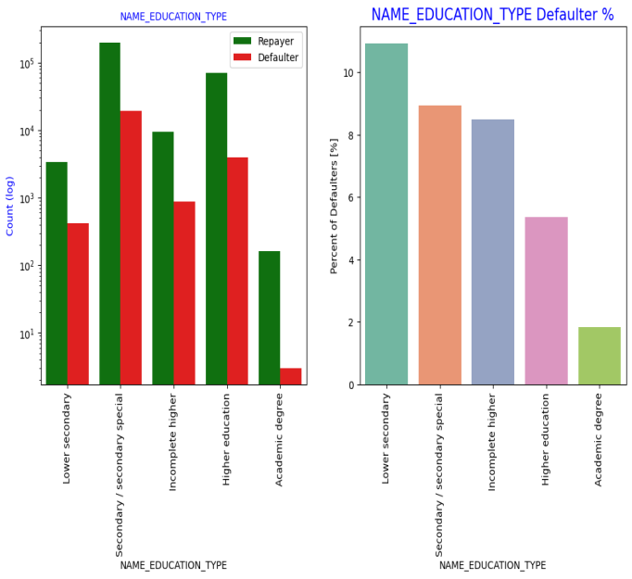
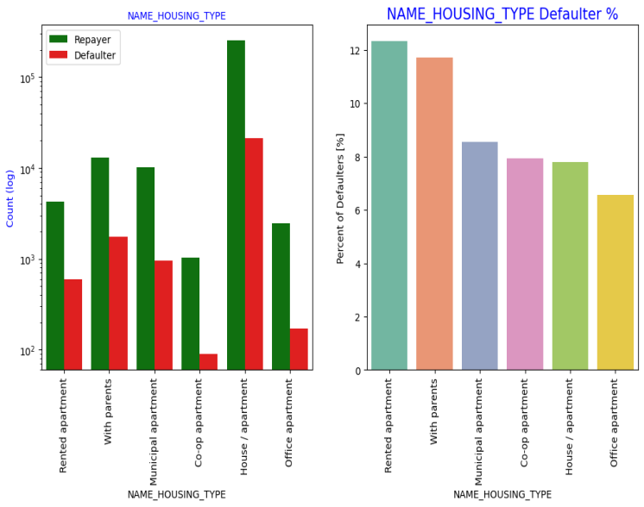
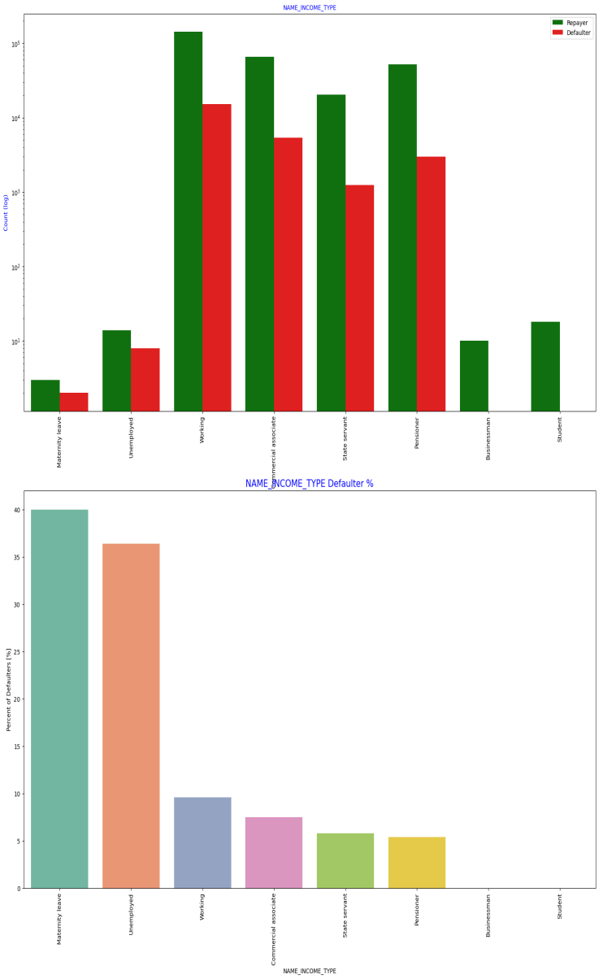
Jsklknlk
Lower secondary, Rented apartment
members and members in maternity
leave have more defaulter percentage
when compared with their respective
attributes.

Slide 17
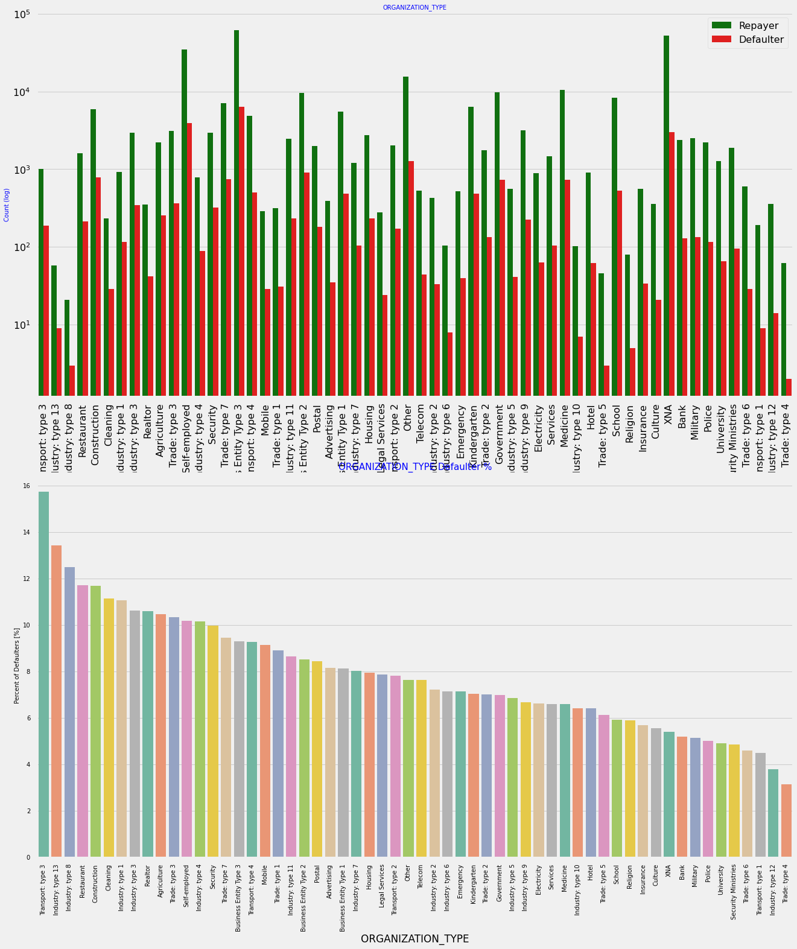
The companies with the largest percentage of loans that have not been repaid fall into the following categories:
Transport: type 3 (16%),
Industry: type 13 (13.5%),
Industry: type 8 (12.5%)
and Restaurant (< 12%).

Slide 18
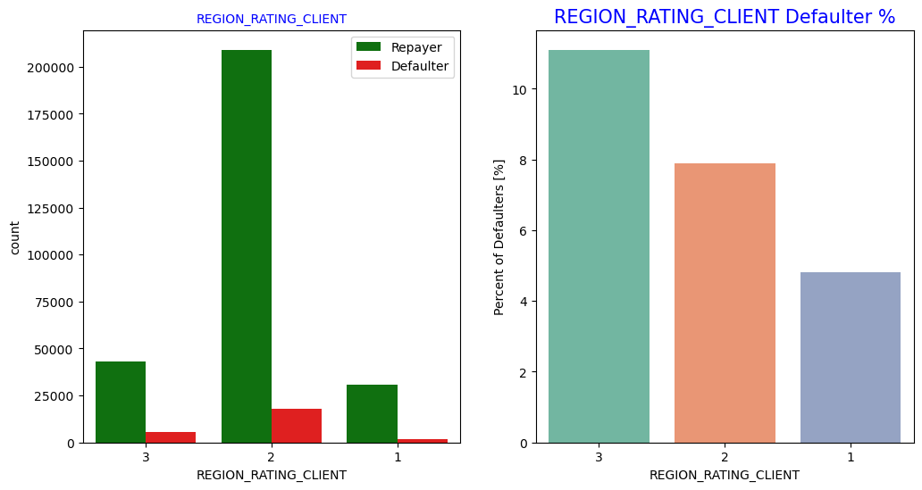
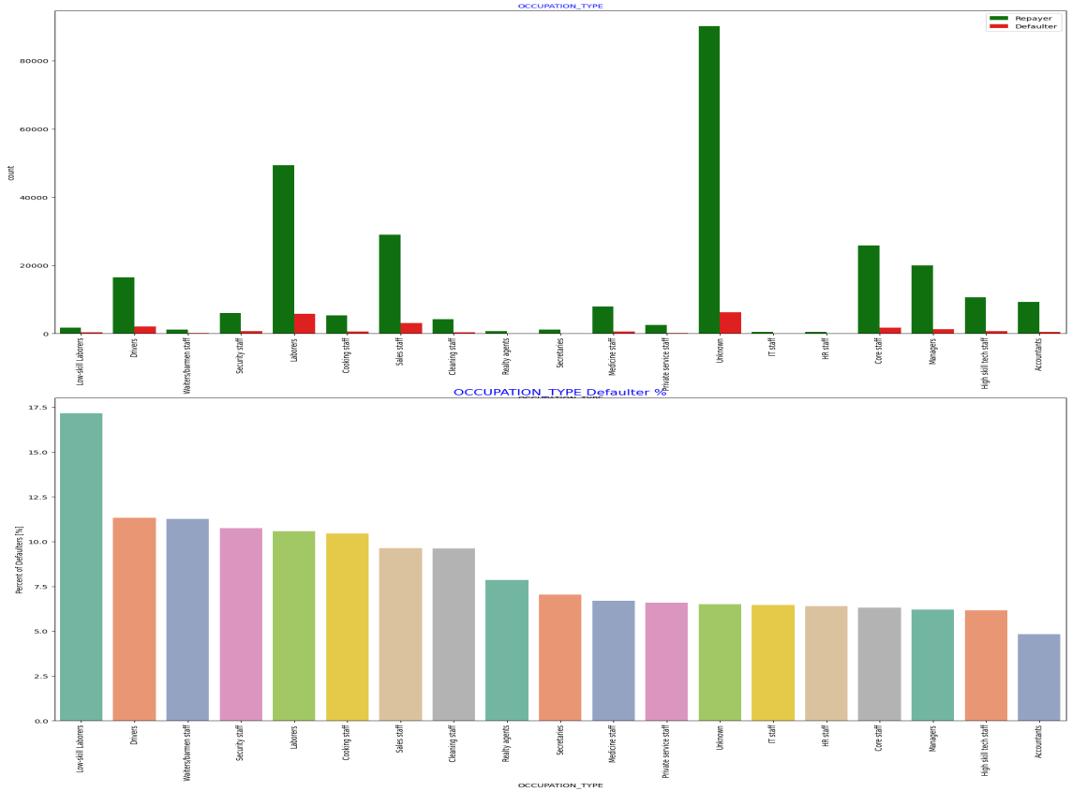
In REGION_RATING_CLIENT
attribute, rating 3 clients have
more defaulter percentage.
In OCCUPATION_TYPE
attribute, low skill laborers,
drivers, bar men etc have
more defaulter percentage.

Slide 19
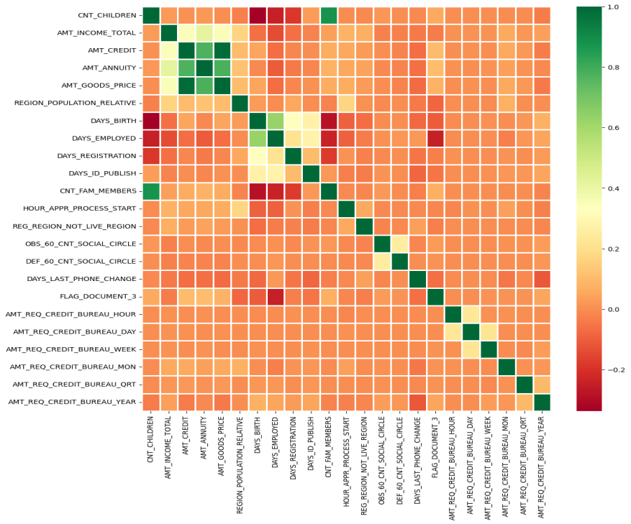
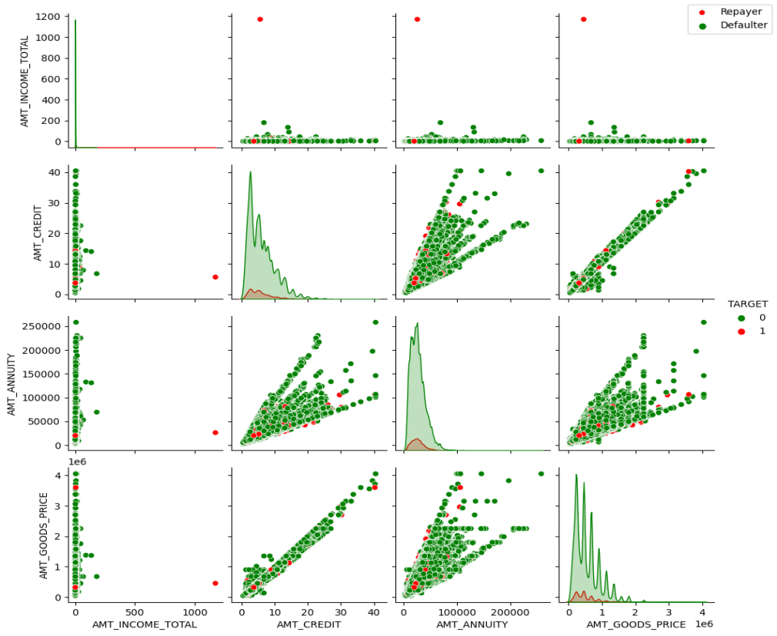
Correlation between numeric variable
Correlating factors among repayers:
Credit amount is highly correlated
with amount of goods price, loan
annuity, total income.
When AMT_ANNUNITY > 15000 AMT_GOODS_PRICE > 3M, there is a lesser chance of defaulters.
There are very less defaulters for AMT_CREDIT > 3M

Slide 20
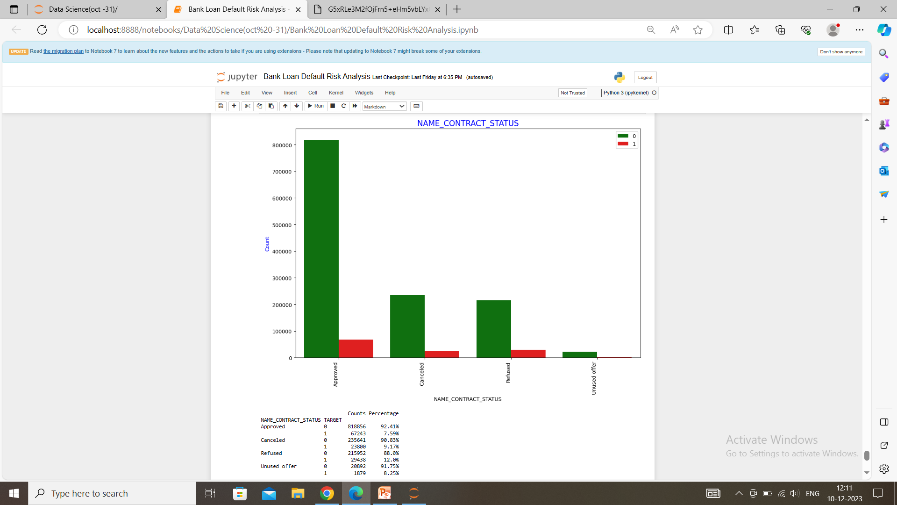
90% of the previously cancelled client have actually repaid the loan. Revisiting the interest rates would increase business opportunity for these clients.
88% of the clients who have been
previously refused a loan has paid
back the loan in current case.
Refual reason should be recorded
for further analysis as these clients
would turn into potential
repaying customer.

Slide 21
CODE_GENDER: Men are at relatively higher default rate
NAME_FAMILY_STATUS : People who have civil marriage or who are single default a lot.
NAME_EDUCATION_TYPE: People with Lower Secondary & Secondary education
NAME_INCOME_TYPE: Clients who are either at Maternity leave OR Unemployed default a lot.
REGION_RATING_CLIENT: People who live in Rating 3 has highest defaults.
OCCUPATION_TYPE: Avoid Low-skill Laborers, Drivers and Waiters/barmen staff, Security staff, Laborers and Cooking staff as the default rate is huge.
ORGANIZATION_TYPE: Organizations with highest percent of loans not repaid are Transport: type 3 (16%), Industry: type 13 (13.5%), have relative high defaulting rate.
DAYS_EMPLOYED: People who have less than 5 years of employment have high default rate.
CNT_CHILDREN & CNT_FAM_MEMBERS: Client who have children equal to or more than 9 default 100% and hence their applications are to be rejected.

Slide 22
CONCLUSION
90% of the previously cancelled client have actually repaid the loan. By recording the reason for cancellation, which might help the bank to determine and with these repaying customers in future to increase business opportunity.
88% of the clients who were refused by bank for loan earlier have now turned into a repaying client. Hence documenting the reason for rejection could mitigate the business loss and these clients could be contacted for further loans.

Slide 23
THANK YOU

